Slide 1



BLOOMS TAXONOMY OF EDUCATIONAL OBJECTIVES
Presented By
Dr.KRISHNA PRIYA S
Principal
Amrita Institutions
Sun College of Education
Amritagiri, Erachakulam, Nagercoil

Slide 2


Slide 3

Recollection…………
Education
Teaching
Learning
Aim
Objective

Slide 4

Process of Teaching-Learning
Input
Process
Output
Outcome

Slide 5
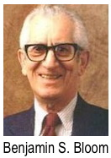
Blooms Taxonomy of Educational Objectives
Designed by Psychologists Dr. Benjamin.S.Bloom
Year 1956
University Chicago

Slide 6

Three Domains
Cognitive - Knowledge field
Affective - Feeling Field or Values
Psychomotor - Doing field or Skills
Every educational activity should be planned to develop all this domain of the learner

Slide 7
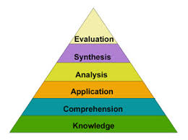
Bloom’s Cognitive domain

Slide 8


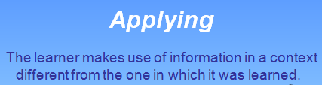




Slide 9
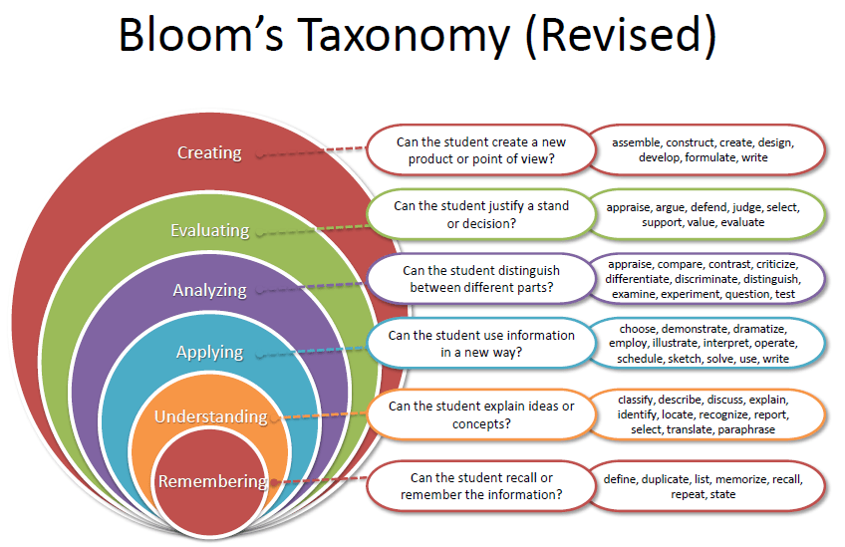
Anderson and Krathwohl’s Cognitive Domain or Bloom’s Revised Taxonomy Action verbs used

Slide 10
Instructional Objectives
General Instructional Objectives
Specific Instructional objectives

Slide 11
Instructional Objectives
Pre-determined learning outcomes of an instruction.
Objectives
Content Part Modification part
Ex: students will be able to state the First Law of Thermodynamics

Slide 12

OBJECTIVES SHOULD BE SMART

Slide 13
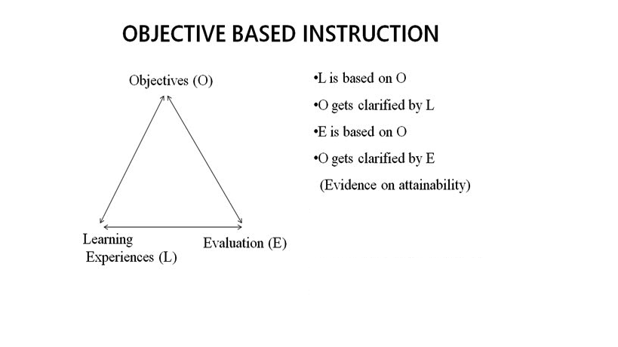

Slide 14
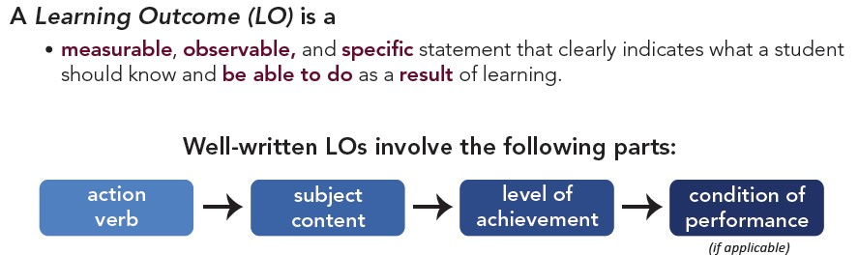
How to write objectives and oucomes

Slide 15
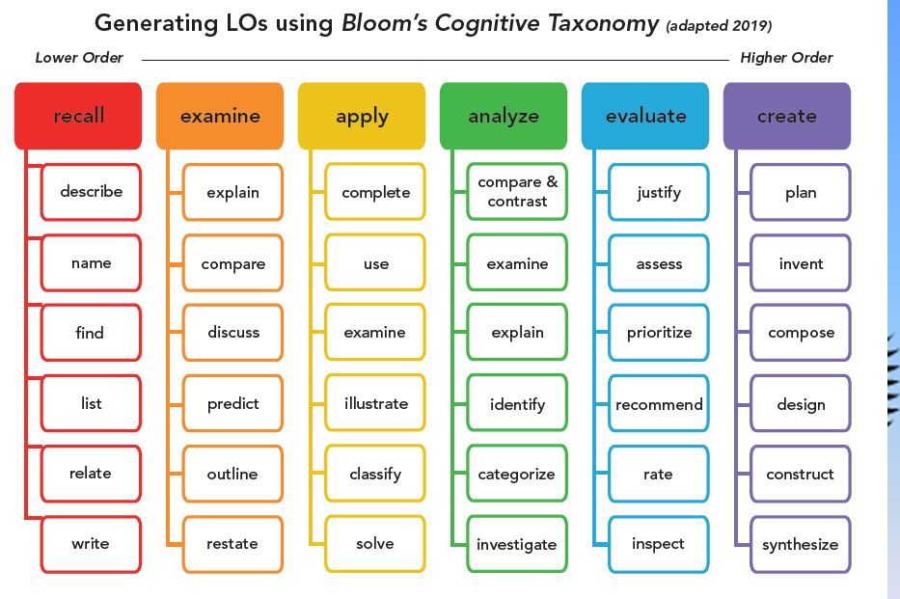

Slide 16
Learning objectives for Blooms Taxonomy
Students acquires knowledge of education, learning, teaching and objectives.
Students will be able to comprehend the three domains of Objectives
Students will be able to apply the level of cognitive domain in new situation
Students will be able to analyse the action verbs to be used in the levels of cognitive domain
Students will be able to evaluate the attainment of objectives
Students will be able to create the outcomes based on objectives.

Slide 17

Learning outcomes
Students will be able to
recall education, teaching , learning , aims and objectives.
identify the three domains in Blooms Taxonomy
define the cognitive domain
list the levels of cognitive domain
explain the six level of cognitive domain
identifies the action verbs for each levels of cognitive domain
cite examples for each levels of cognitive domain
write the general and specific objectives for a topic

Slide 18
Learning outcomes …….
categorises the appropriate action verbs for the suitable content.
select the suitable action verbs for the content
formulate the learning outcomes for each topic.

Slide 19
Summary

Slide 20
References
Sivarajan, K. (2007). Science teaching. Calicut University Press:Calicut.
Kulsherstha, S.P.(2016). Teaching of Science. Lall Publishers: Meerut.
Alfred Issac, (2008). Technology of teaching English.
https://thepeakperformancecenter.com/educ ational-learning/thinking/blooms- taxonomy/blooms-taxonomy-revised/.
Retrieved on 10th May 2020

Slide 21


